Slide 1
Smart Attendance System Using Face Recognition
by Logesh D (220701144)
Guide DR. V. AUXILIA OSVIN NANCY..,MTech..,Phd..,

Slide 2
Introduction
The Face Recognition Attendance System is a Python-based application that automates the attendance process using facial recognition technology.
It aims to eliminate manual entry errors, reduce the risk of proxy attendance, and streamline check-in processes in real-time.
The system uses pre-trained facial encodings generated from user datasets to identify individuals accurately through webcam input.
The system allows users to register, train models, and take attendance efficiently while storing logs securely in a CSV format.

Slide 3
Literature Survey
Face Recognition in Biometric Systems:
Face recognition is a popular biometric method for identity verification due to its non-intrusive nature. Key algorithms include Eigenfaces (1991), Fisherfaces (1997), and modern deep learning methods like DeepFace (2014), which enhance recognition accuracy.
Automated Attendance Systems:
Traditional attendance methods (e.g., paper-based, RFID) are prone to errors like buddy punching. Automated systems using face recognition, like Patel et al. (2016), eliminate these errors and are widely used in education and corporate settings.
Machine Learning in Face Recognition:
Deep learning methods, particularly Convolutional Neural Networks (CNNs), have revolutionized face recognition. FaceNet (2015) and VGG-Face are widely used for high-accuracy recognition. Transfer learning allows models to generalize well to new individuals.

Slide 4
Literature Survey
Dataset Creation:
Robust face recognition requires large, diverse datasets. Notable datasets like LFW (Labeled Faces in the Wild) and CASIA-WebFace are crucial for training models.
Challenges:
Variations in lighting, aging, and occlusions can affect face recognition accuracy. Research focuses on improving alignment and using multi-modal data (e.g., face + voice) to address these issues. Privacy concerns are also significant, especially regarding the storage and use of biometric data.
Tools and Libraries:
OpenCV and face_recognition (built on dlib) are popular tools for implementing face recognition due to their efficiency and ease of use. These libraries handle face detection, alignment, and recognition with minimal setup.

Slide 5
Objectives
Eliminate manual attendance errors: Reduces human errors in attendance marking by automating the process.
Prevent proxy attendance: Ensures that only the registered individual is marked as present by recognizing their face in real-time.
Improve efficiency and accuracy: Provides a fast, secure, and contactless method for attendance recording.
Maintain a digital log: Automatically logs attendance with a timestamp in a CSV format for future reference and auditing.
User-friendly interface: Allows easy registration, training, and attendance marking, making it accessible for both administrators and users.

Slide 6
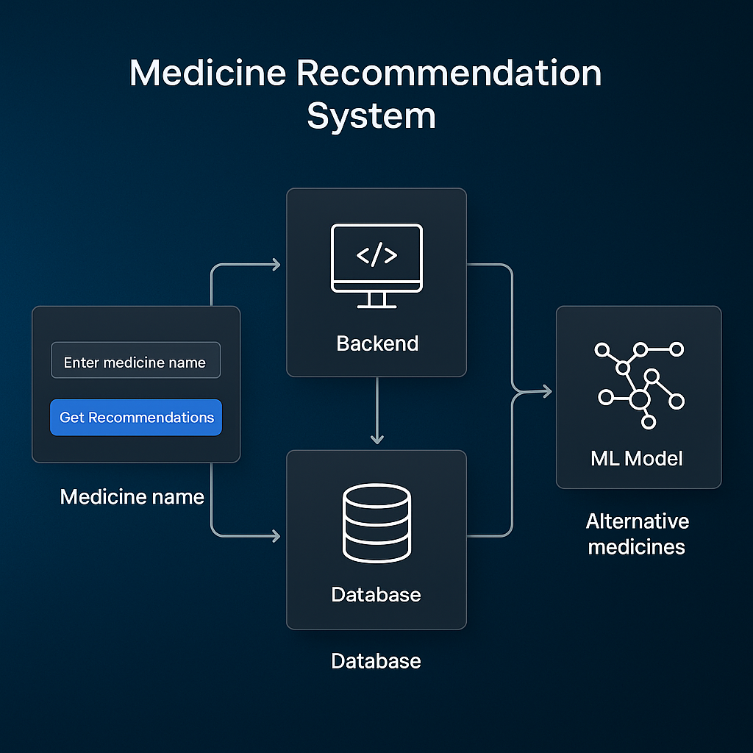
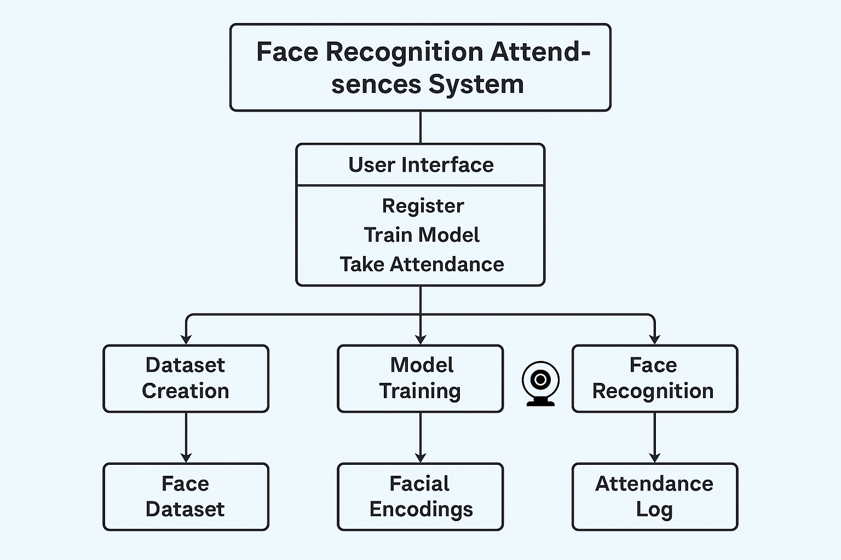
System Architecture

Slide 7
Methodology
Data Collection: Capture and store facial images of individuals, labeling them with their names in a structured directory.
Face Encoding & Model Training:
Extract facial embeddings using libraries like Face Recognition or OpenCV.
Store embeddings with names in a database (CSV/SQLite).
Train the recognition model with the collected data.
Face Detection: Use a pre-trained face detector (e.g., Haar Cascades, Dlib) to detect and crop faces from images.

Slide 8
Methodology
Real-time Recognition:
Capture real-time video feed from the webcam.
Detect faces, extract embeddings, and match with stored embeddings to identify individuals.
Attendance Logging:
If a match is found, log the individual's name and timestamp in an attendance log (e.g., CSV).

Slide 9
Implementation
Capture Faces for Registration:
The system uses OpenCV to capture video frames from the webcam.
It detects faces in real-time using face_recognition and allows users to register by pressing a key
The captured face images are stored in a structured directory with the person's name for later encoding.
Encode Faces and Store in Database:
All captured face images are processed to extract facial embeddings (features) using face_recognition.
The embeddings are stored in a file
This creates a database of known faces that the system can reference when recognizing faces in real-time.

Slide 10
Implementation
Real-Time Face Recognition:
The webcam captures live video frames where the system detects faces using face_recognition.
Each detected face is compared with the stored facial embeddings, and if a match is found, the person is identified.The system records attendance by logging the person’s name and timestamp into a CSV file .
Attendance Log:
The system creates a record of all recognized faces with the timestamp of when they were identified,
storing this in a CSV for tracking attendance

Slide 11
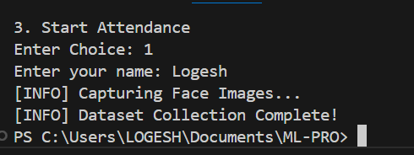
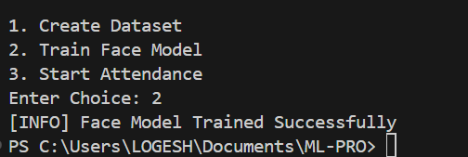
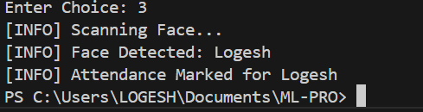
Results

Slide 12


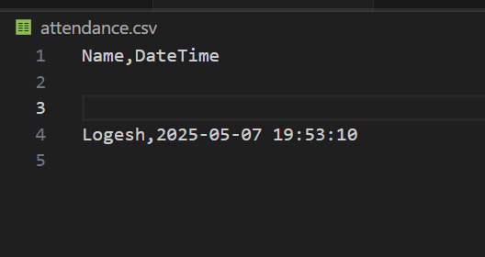
Results
Face Matched

Slide 13
Comparison with existing work
Existing Systems:
Traditional attendance systems include manual registers, RFID cards, and biometric fingerprint scanners. These methods are widely used but are prone to issues like human error, proxy attendance, hygiene risks, and the need for dedicated hardware.

Slide 14
Comparison with existing work
Our Approach
Our system uses face recognition technology to automate attendance. It captures facial features using a webcam, identifies individuals in real-time, and logs their attendance without any manual input or physical contact.
Key Differences
Unlike traditional systems, our approach is fully contactless, more hygienic, and cost-effective. It also enables real-time attendance tracking with higher accuracy and minimal hardware requirements, making it ideal for modern institutions and workplaces.

Slide 15
Conclusion and Future Work
Conclusion:
The proposed Face Recognition-based Smart Attendance System provides a secure, accurate, and contactless solution for managing attendance in real-time. By replacing traditional and touch-based methods, it minimizes manual errors, prevents proxy attendance. The system is easy to deploy with basic hardware and demonstrates strong potential for practical use in educational institutions, offices, and public sectors.
Future Work:
In the future, this system can be enhanced by integrating it with cloud storage for centralized attendance management, mobile apps for remote access, and advanced liveness detection to prevent spoofing using photos or videos. Additionally, incorporating AI-based analytics and real-time alerts can further improve decision-making and system responsiveness.

Slide 16
THANK YOU

